Slide 1


Online Doctor Appointment Booking Web Application
Paavai College of Engineering
Department of Computer Science and Engineering
Submitted by,
Submitted to,
Jotheeswaran v
Pooja Ramaraj,
ByteXL Trainer.

Slide 2
Abstract
The Online Doctor Appointment Booking Web Application is a user-centric platform designed to streamline the healthcare appointment process by connecting patients with doctors through a digital interface. This web-based system allows users to search for doctors by specialty, location, and availability, and to book, reschedule, or cancel appointments with ease. It also provides doctors with a secure portal to manage schedules, view patient details, and maintain appointment history. The system enhances accessibility, reduces administrative workload, and minimizes waiting time through real-time updates and notifications

Slide 3
Problem Statement
In many clinics and hospitals, appointment scheduling is still done manually, leading to confusion, overlapping bookings, and wasted time. Patients often have to wait in long queues or make multiple calls to fix an appointment.. This traditional method is inefficient, time-consuming, and highly prone to human error. Patients often experience long waiting times, overlapping schedules, and unnecessary delays, which negatively impact their overall healthcare experience.

Slide 4
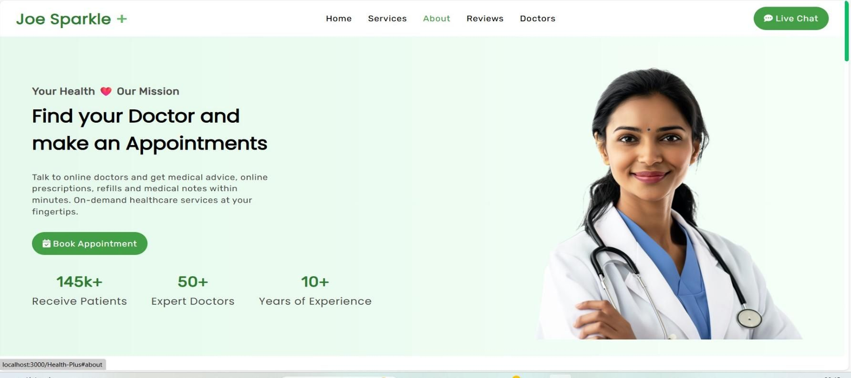
Home Page Of My Project

Slide 5
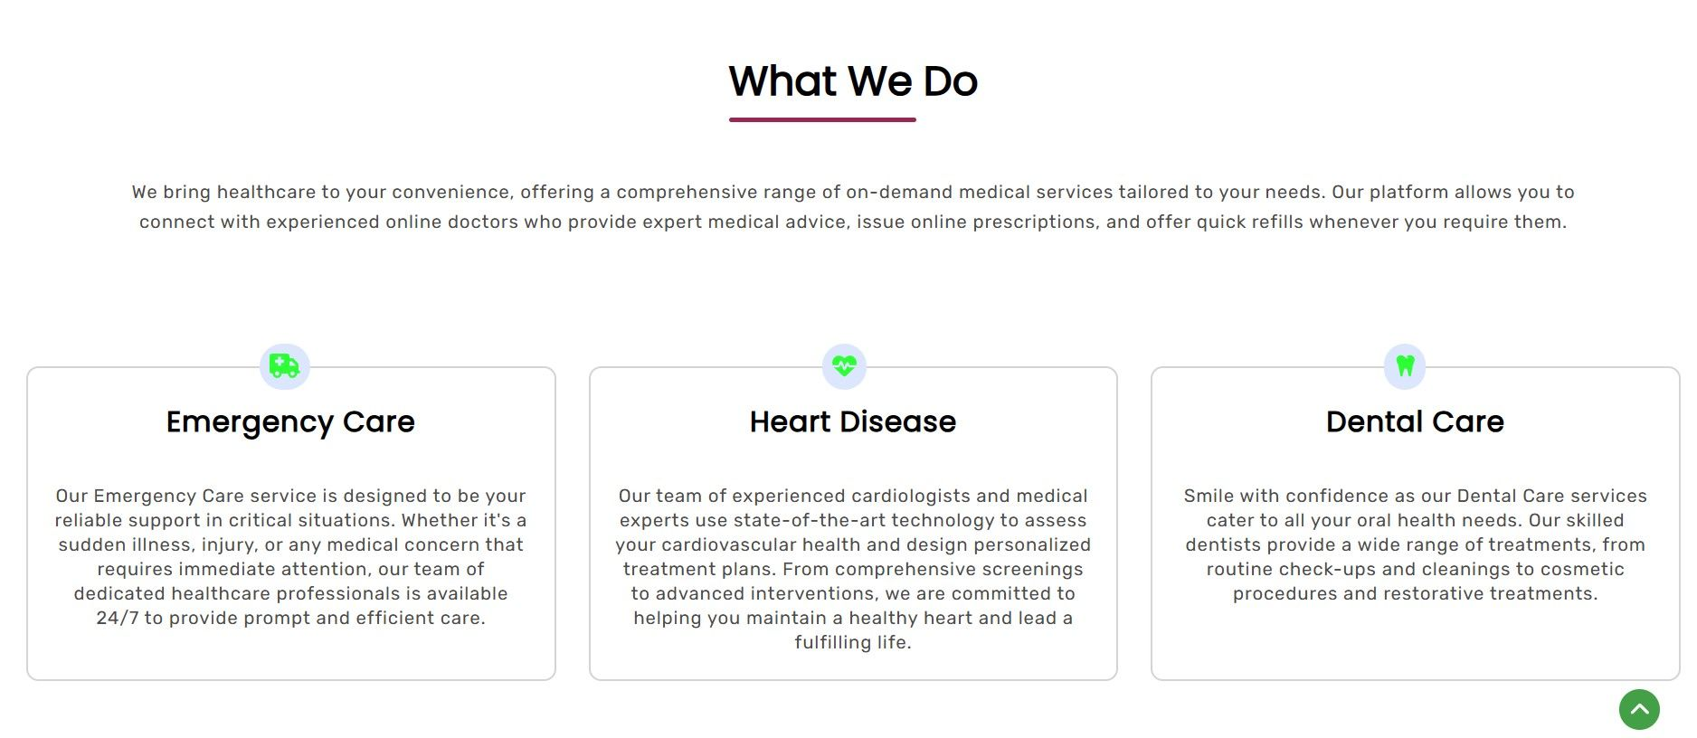
Featured Services

Slide 6
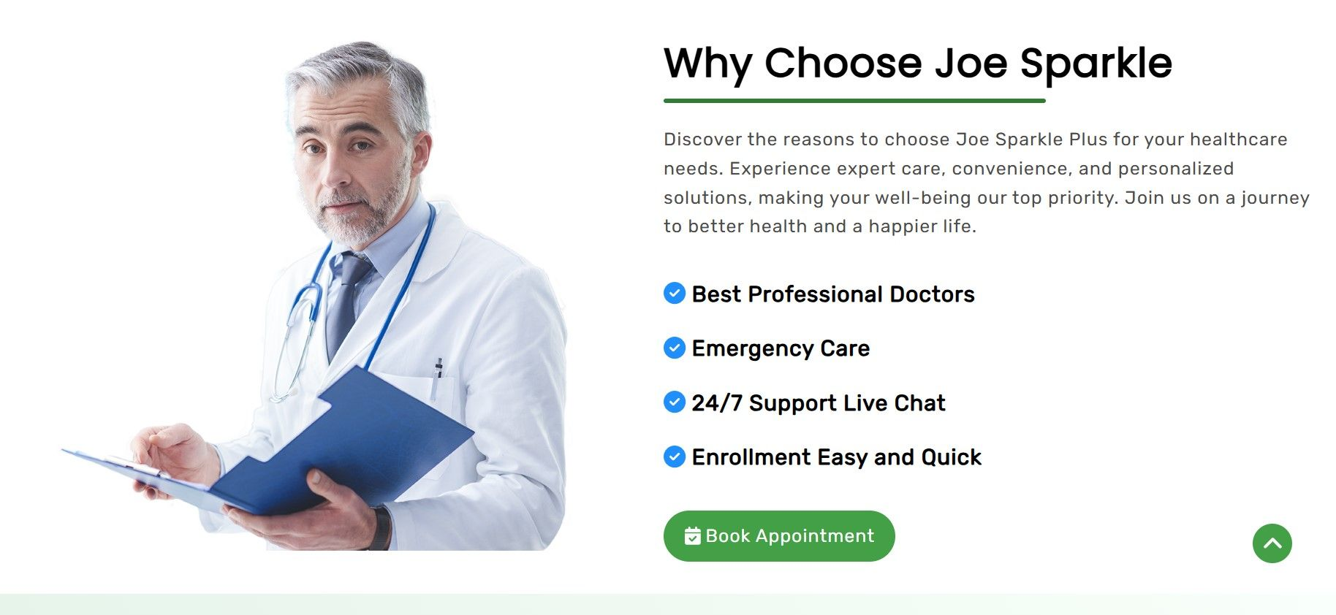


Features

Slide 7
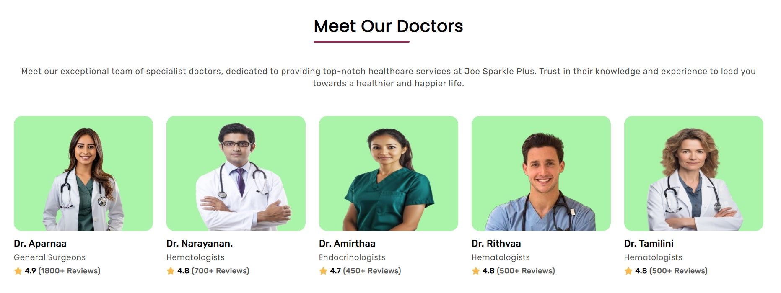
Choose Your Doctor

Slide 8
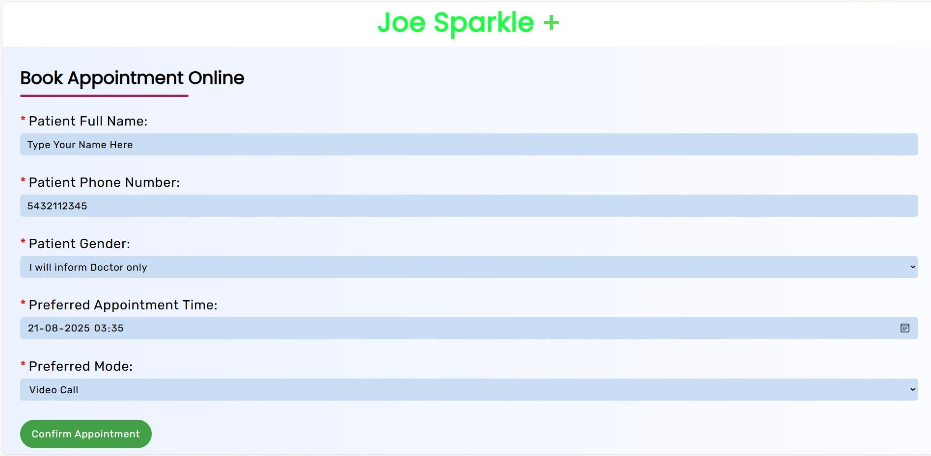

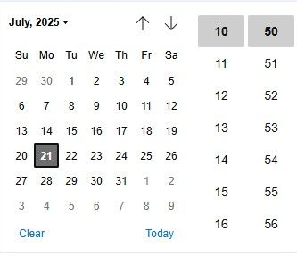
Booking Appointment

Slide 9
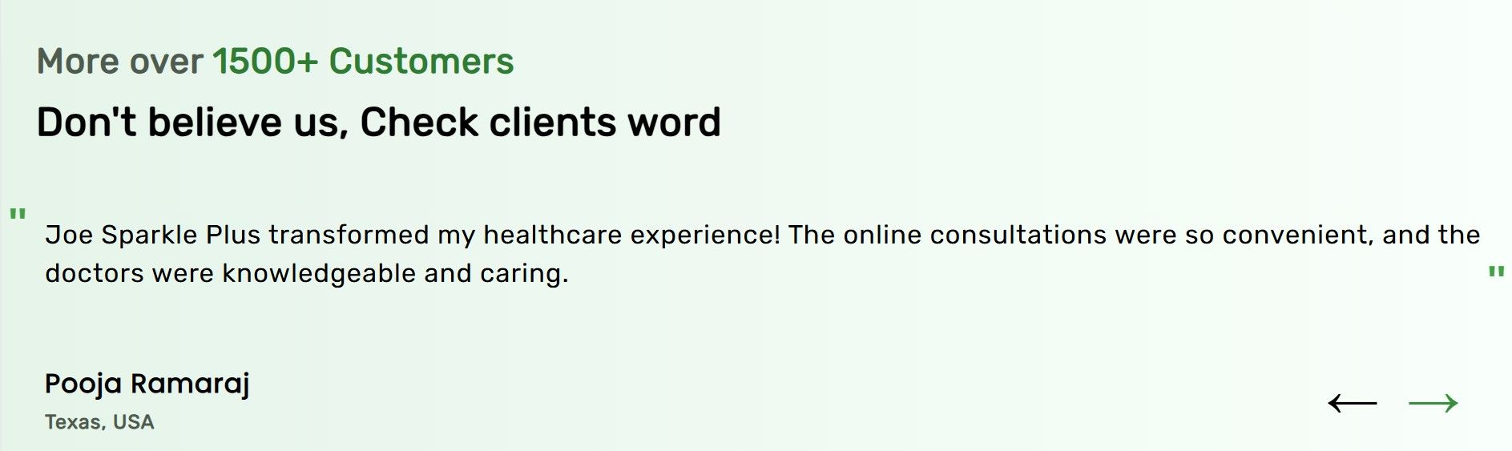
Customer reviews

Slide 10
Advantages
Faster Performance
Many Domains
Customizations
24/7 Available
Time Saving
Easy to Use
Select Customized Doctors

Slide 11
Disadvantage
No Database Used it is Just an model
Not able connect voice call due to not Communication Network Support
Depends upon the Doctor Availability
Time consuming when More user Process at a same time
Difficult to maintain 24/7 live streaming video calls

Slide 12
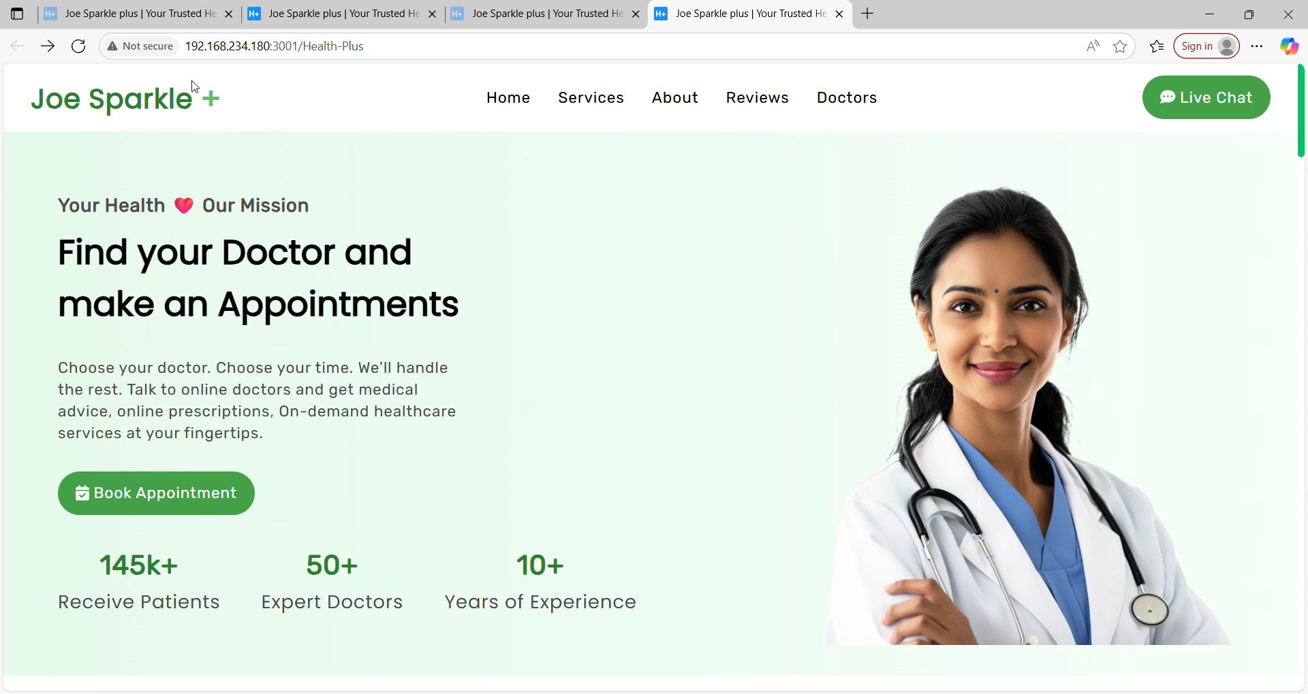
Final Execution of Joe Sparkle

Slide 13
Conclusion
Joe Sparkle Plus is Web application which useful for consulting Healthcare Specialists without reaching hospital or health centres , It saves time and serves the Knowledge about Our health . Sometime even a Experienced doctor can also do Mistake due to low knowledge about the body condition so selecting Joe Sparkle always should be second choice and not recommended to trust Fully . Consulting the Doctor in real meet is best and not suitable for Critical health issues. The doctors from the Joe Sparkle able to provide advice and reports possible solution for the health issues not able to cure by Online.

Slide 14


